Slide 1

Data ANALYTICS Project : HAPPINESS EQUATION
Joe Marrone
Craig Fulgency
Ashish Kumar
Jamal Abdi

Slide 2
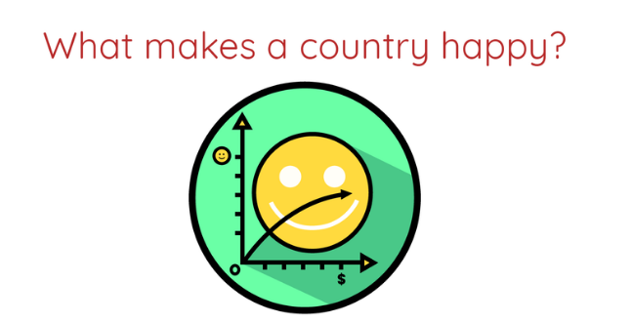
Overview
The goal of this project is to analyze country’s various metrics like education, healthcare etc. and compare it to the happiness index score given by the World Happiness Report 2020.
This project will let us study the impact of important factors that lead up to a happy country.
Questions raised:
Do the number of healthcare locations in an area reflect the Happiness Score of that country?
Does education has a role in country’s citizens happiness?
Does having an extensive transportation system lead to a happy nation?
Does have means of entertainment help keep people happy?

Slide 3

Considerations
With the help of Google Map APIs keyword search, we can locate number of Healthcare facilities , Education institutions, Transportation facilities and Entertainment locations
The search was limited to a 750 meter radius of the Capital Cities of each selected country in the sample.
11 countries were shortlisted based on their comparable capital city area.
Sources used : 1)Happiness Report https://worldhappiness.report/ed/2020/ 2)Google Maps Api https://developers.google.com/maps/documentation/geocoding/overview 3)Health Expenditure per country https://data.worldbank.org/indicator/SH.XPD.CHEX.GD.ZS
Technologies used in this project : Google Maps APIs, Pandas, Python, Matplotlib and Jupyter Notebook.
Each slide will deal with a particular issue and answer the question raised in previous slide
Ladder score of happiness data was increased by factor of 10 to scale the data similarly

Slide 4
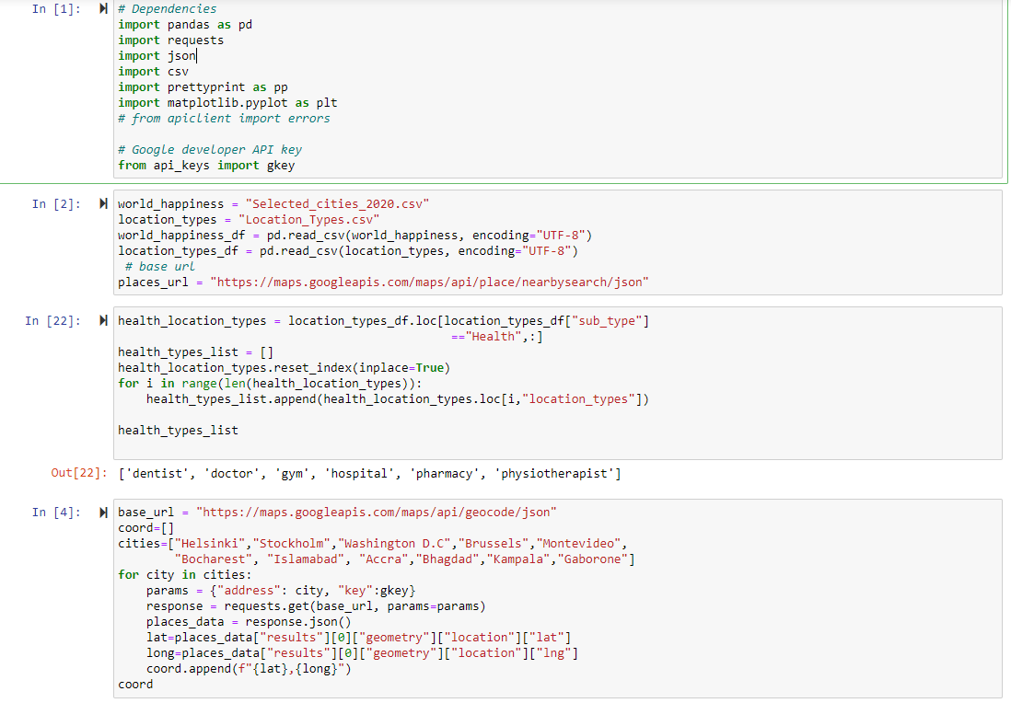
Code

Slide 5
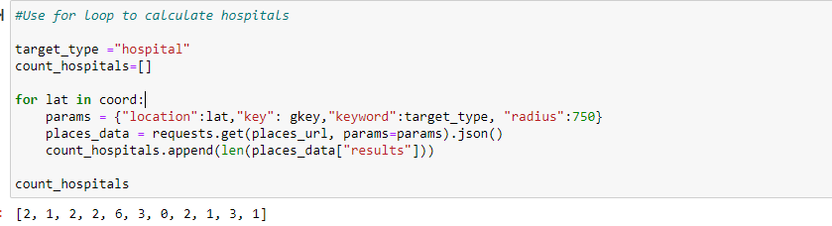
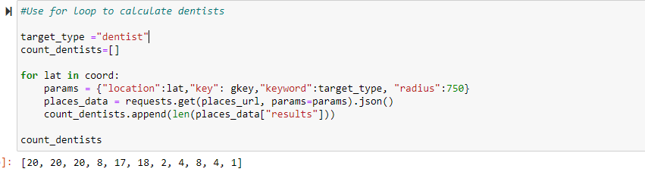
Code Cont.

Slide 6
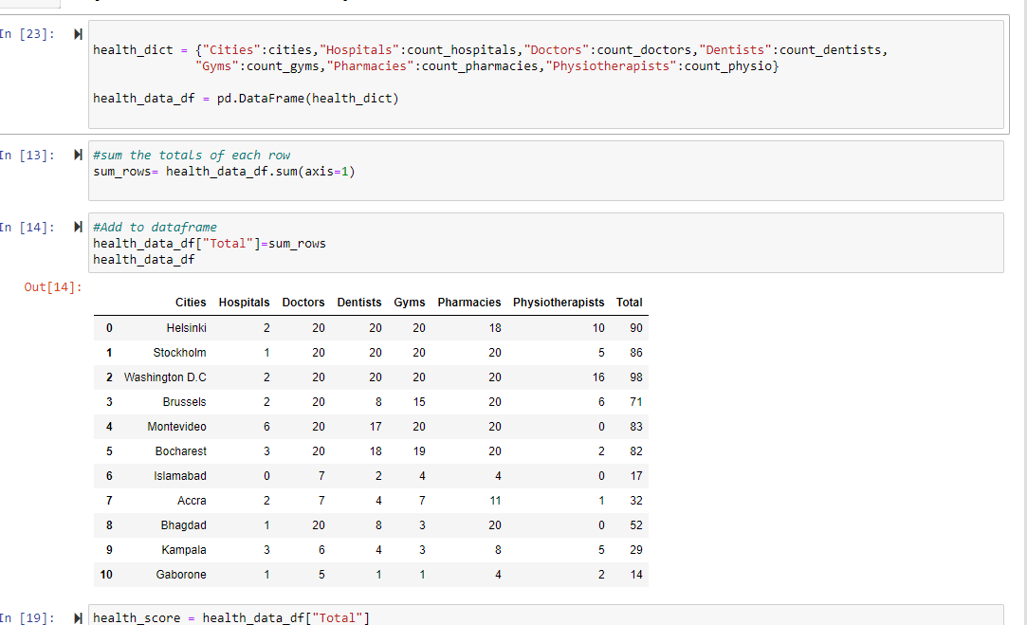
Code Cont.

Slide 7
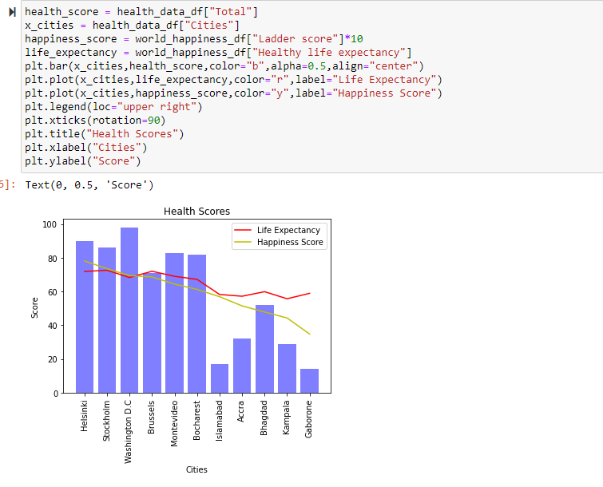
Code Cont.

Slide 8
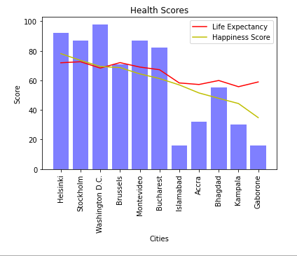
Factor 1 : HealthCARE
A healthy lifestyle is important to one’s happiness. Country’s focus on providing healthcare services to its citizens can effect its happiness score as seen by this bar chat below.
Another factor considered here is Life Expectancy. The World Happiness Report also provides the life expectancy age in each country.
Health Location Types taken in account : 'dentist', 'doctor', 'gym', 'hospital', 'pharmacy', 'physiotherapist'
Countries & Capital City
Finland – Helsinki
Sweden – Stockholm
USA – Washington D.C
Belgium – Brussels
Uruguay – Montevideo
Romania – Bacharest
Pakistan – Islamabad
Ghana – Accra
Iraq - Bhagdad
Uganda – Kampala
Botswana - Gambrone

Slide 9
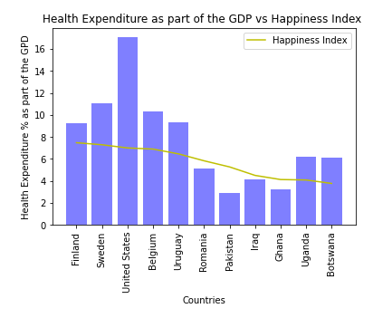
Health Expenditure (% of the GDP)
Using World Health Organization Global Health Expenditure database, we wanted to see how much each
country spends on their healthcare services.
This graphs shows that spending on heath doesn’t always means a happier country. But keep in mind these
Countries have a varied population size.

Slide 10
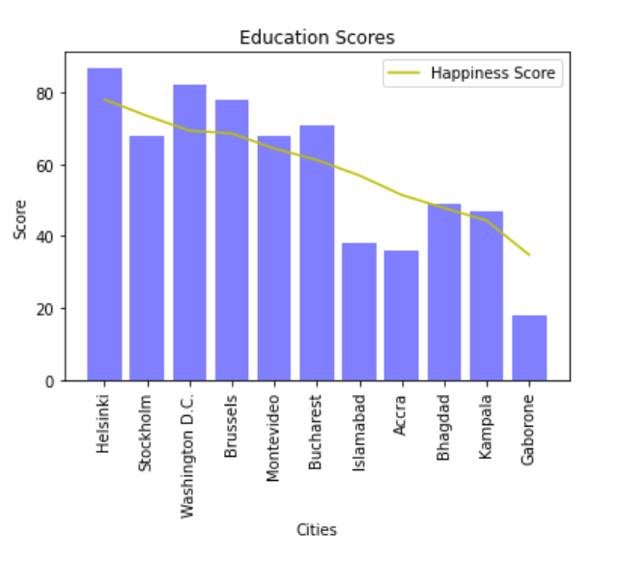
FACTOR 2 : education
Education plays a key role in country’s financial success but does it help with happiness?
The graph proves that countries with multiple education intuitions keeps citizens its happy.
Education Location Types: ‘library', ‘museum', ‘primary school', ‘school', ‘secondary school', ‘university'

Slide 11
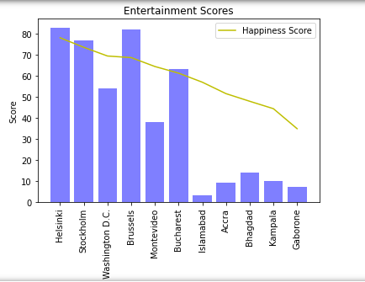
FACTOR 3 : Entertainment
Having means of entertainment in the city can help people take a break from a busy/stressful life.
The graph shows entertainment is directly proportional to the happiness index
Entertainment Location Types: 'amusement_park', 'aquarium', 'art_gallery‘, 'movie_theater', 'night_club', 'stadium', 'tourist_attraction', 'zoo'

Slide 12
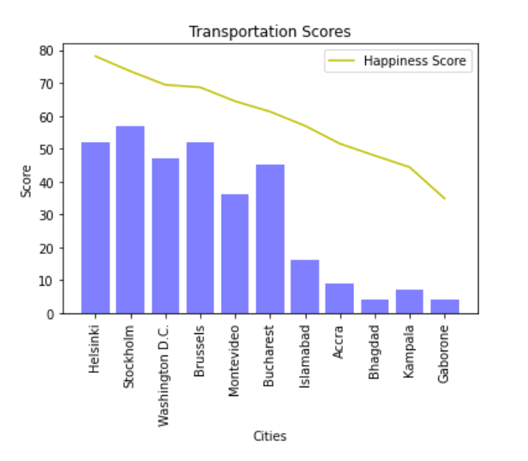
FACTOR 4 : transportation
Easy and fast transportation helps citizens live stress-free life. The graph depicts the same.
Having multiple transport mediums helps people travel with ease, hence contributing to less stress.
Transportation Location Types: ‘airport', ‘bus_station', ‘light_rail_station', ‘subway_station', ‘train_station', ‘transit_station'

Slide 13
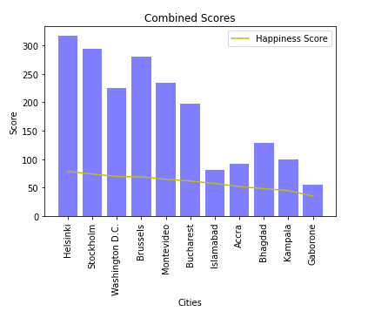
Combined totals
Combined view of location totals

Slide 14
What we would have done with more time
We would have looked for sources that can give us data on how much these countries spend on mental health. That would have helped solidify our research.
We wanted to compare the happiness score to the population size of the country? Do smaller countries tend to be more happy or vice versa?

Slide 15
Finish.

